Slide 1

IMAGE
CAPTION
GENERATOR

Slide 2
DESCRIPTIVE
IMAGE
CAPTION

Slide 3
CG - DESCRIPTIVE IMAGE CAPTION
CG, a descriptive image caption generator, enhances accessibility and boosts SEO efforts. Furthermore, it aids in contextual understanding and enables advanced AI applications as it open up new possibilities for automation and efficiency in image-related tasks.

Slide 4
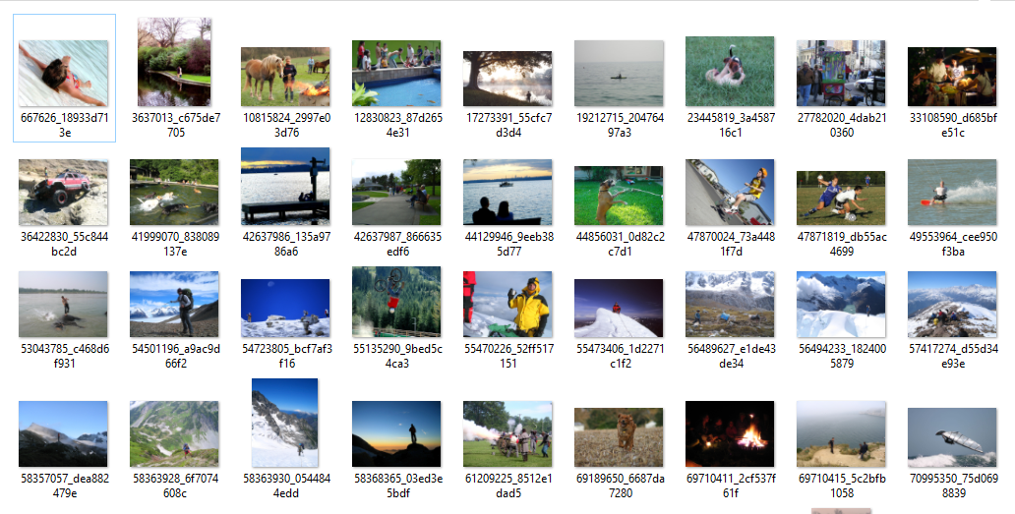
DATASET
Flickr_8K Images

Slide 5
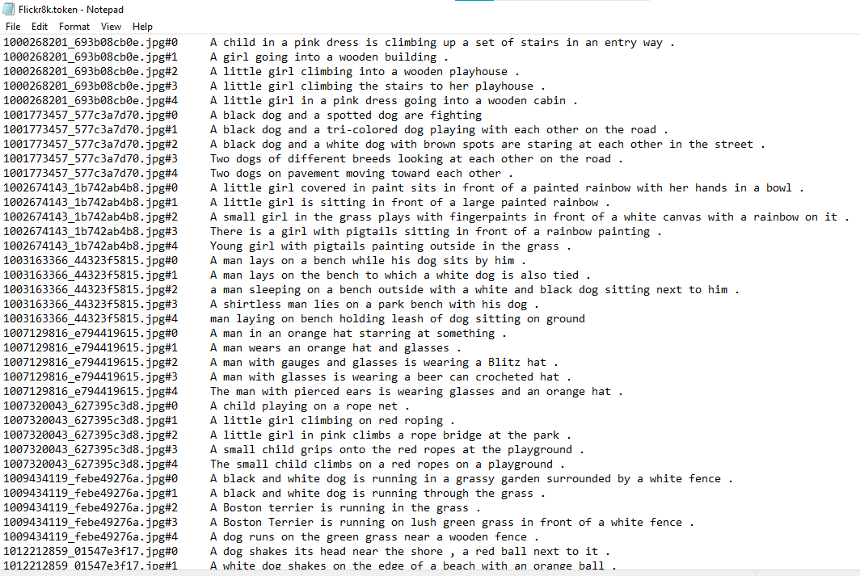
Flickr_8K Image Captions

Slide 6
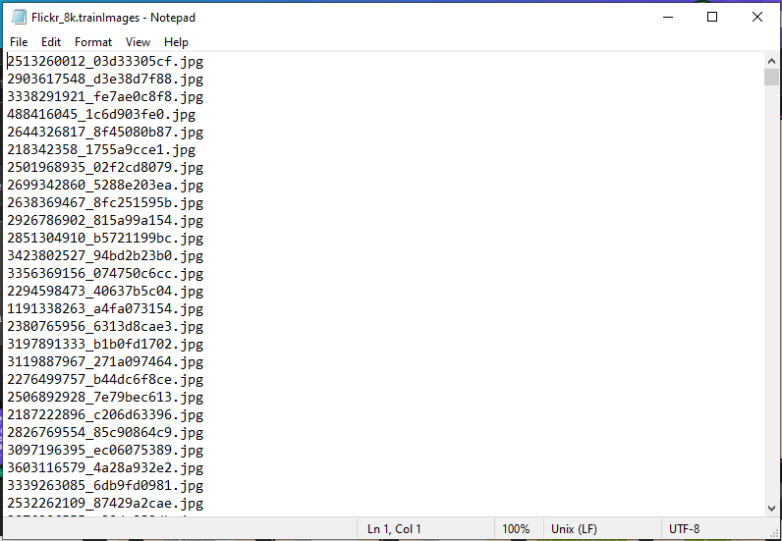
Flickr_8K Train Images

Slide 7
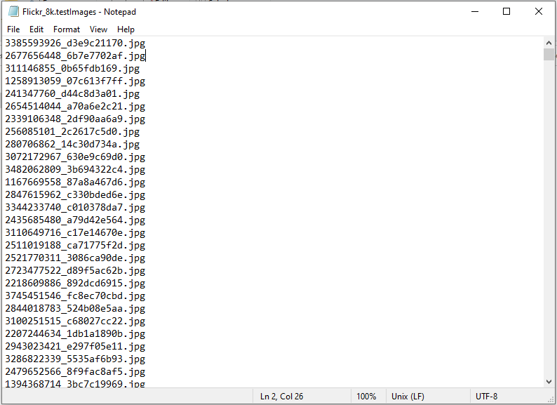
Flickr_8K Test Images

Slide 8

MACHINE LEARNING MODEL
XCEPTION MODEL
The Xception model is employed as the "encoder" component. It was utilized as a feature extractor that analyzed the input image and extract meaningful features from it.

Slide 9
MACHINE LEARNING MODEL
LONG SHORT
TERM MEMORY
The Long Short-Term Memory (LSTM) model was utilized as the "decoder" component. It was used to generate﻿ a textual description or caption for a given input image.

Slide 10
BUILDING THE IMAGE CAPTION GENERATOR

Slide 11
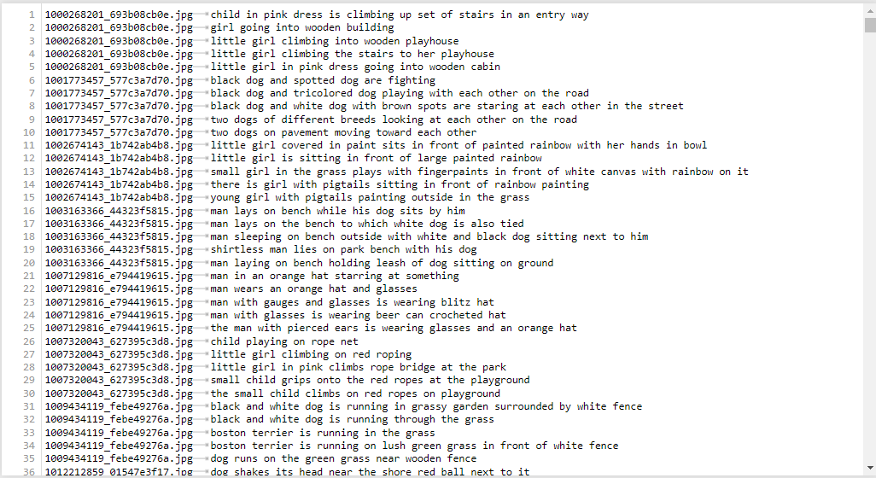
Clean Up Text Descriptions

Slide 12
Extract Features
Xception Model is used to extract features from the images
Resizing the images (299 x 299)
Normalize pixel values
model.predict()

Slide 13
Tokenize the Vocabulary
Built-in tokenizer function in Keras library
tokenizer.fit_on_texts()
Save tokens in a pickle file (tokenizer.p)

Slide 14
Define the Image Caption Model
Used Keras Model to define the structure of the image captioning model
Feature Extractor
Sequence Processor (LSTM sequence model)
Decoder (Merging the outputs of the CNN Model and LSTM sequence)

Slide 15
Generate Data for the Image Caption Model
Feature vector and Text Sequence are taken as inputs
Output is the text sequence predicted by the model
[feature vector, text sequence]
[word to predict]
feature
start,
dog
feature
start, dog
running
feature
start, dog, running
grass
feature
start, dog, running, grass
end

Slide 16
DEMO

